Slide 1
SELF DISCLOSURE
16:35

Slide 2
Objectives: Self-Awareness & Self-Esteem
Explain the Johari window.
Compare & contrast Johari window for two different relationships.
Discuss rewards & risks of self-disclosure.
List & explain guidelines for self-disclosure.
List & explain guidelines for responding to self-disclosures of others.
16:35

Slide 3
II. Self-Awareness
Johari Window -- a tool that represents your communication behaviors
Goal is to be as open a communicator as appropriate.
16:35

Slide 4
Known to Not Known
Self to Self
Open
Self
Known to
Others
Not Known
to Others
Blind
Self
Hidden
Self
Unknown
Self
Johari Window
16:35

Slide 5
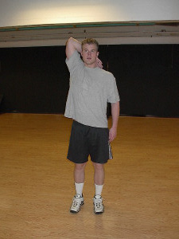

III. Self-Esteem – your own evaluation of worth
CLUES?
A. Attack your self- destructive beliefs.
B. Engage in self-affirmation.
Seek out nourish-
ing people.
Work on projects that will result in success.
Way to go!
16:35

Slide 6
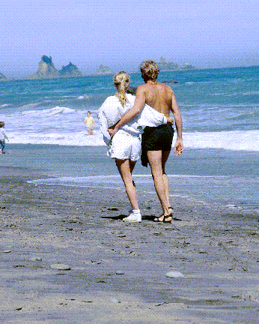
IV. Self-Disclosure -- sharing previously unknown personal information with another
values
behavior
beliefs
qualities
desires
characteristics
16:35

Slide 7
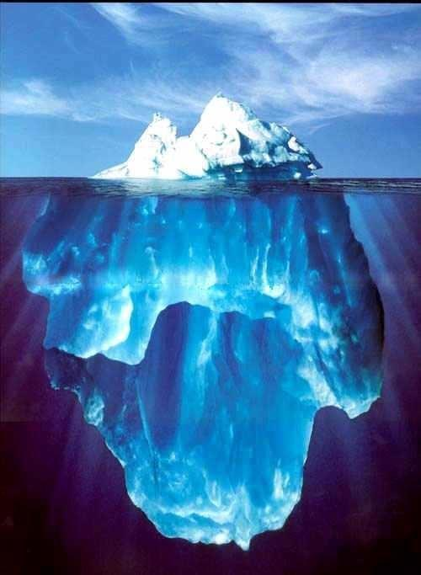
16:35

Slide 8
A. Factors Influencing Self- Disclosure
1. Who You Are
2. Culture
3. Gender
4. Your Listeners
5. Topic
16:35

Slide 9
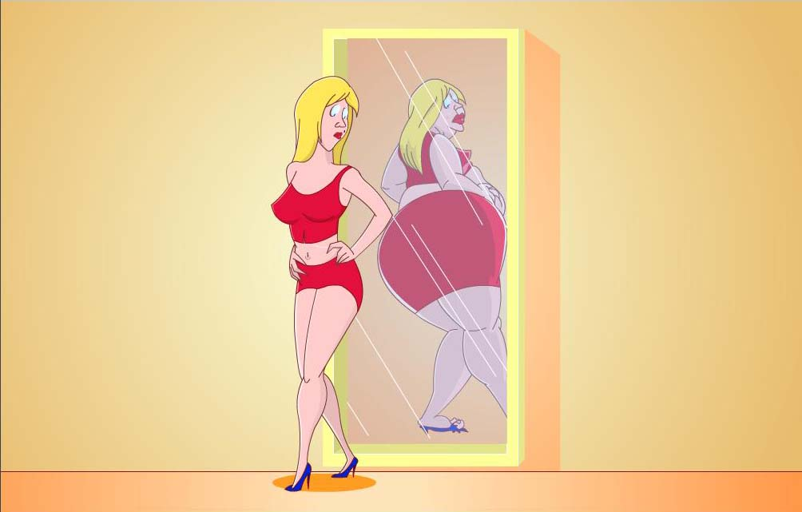
WOMEN
16:35

Slide 10
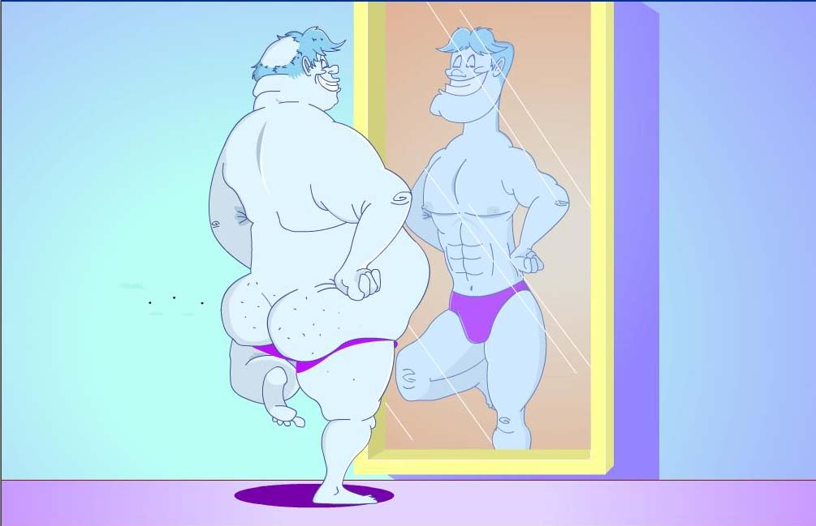
MEN
16:35

Slide 11
Weigh the rewards against the risks before deciding to self- disclose.
CAUTION!
16:35

Slide 12
B. Rewards of Self- Disclosure
1. Get to know self better
Increases communication effectiveness
3. Increases physiological health
16:35

Slide 13
C. Dangers of Self- Disclosure
1. Personal risks
2. Relational risks
3. Professional risks
16:35
Experiential Vehicle, Devito Website

Slide 14
Guidelines for Self-Disclosure
Consider the:
motivation.
appropriateness.
disclosures of the other.
possible burdens.
16:35

Slide 15
Guidelines for Responding to Self-Disclosures of Others
Use active listening skills.
Support & reinforce the discloser.
Keep disclosures confidential.
Do not use disclosures as weapons.
16:35

Slide 16
Objectives: Apprehension
Define communication apprehension & distinguish between state & trait apprehension.
List 7 apprehensive behaviors.
List & explain 7 influences on apprehension.
Explain how cultural differences impact apprehension.
Briefly describe 3 apprehension management theories.
16:35

Slide 17
V. Apprehension
A. Nature of comm. apprehension
1. Comm. apprehension--fear/anxiety about interaction
2. Trait apprehension--fear of comm., regardless of situation
3. State apprehension--specific to a given comm. situation
16:35

Slide 18
B. Apprehensive Behaviors
1. Decrease in frequency, strength, & likelihood of engaging in comm.
2. Less willing to volunteer
3. Lack of satisfaction w/dating
4. Talk less & avoid leadership
5. Disclose less
6. Avoid jobs requiring comm.
7. Less likely to get job interviews
16:35

Slide 19
C. Influences on comm. apprehension
1. Degree of evaluation
2. Subordinate status
3. Degree of conspicuousness
4. Degree of unpredictability
5. Degree of dissimilarity
6. Prior success & failures
7. Lack of comm. skills & experience
16:35

Slide 20
D. Culture & apprehension
1. Apprehension increases w/unfamiliarity
2. Higher if you have stereotypes, prejudices
3. Situation influences--ambiguity, status, perception of evaluation
16:35

Slide 21
E. Apprehension Management Theories
1. Cognitive Restructuring--change unreal- istic beliefs which cause fear of failure
2. Systematic Desensitization--unlearn apprehension--creating hierarchy of behaviors leading up to desired behavior
3. Skill Acquisition--
a. Prepare & practice
b. Focus on success
c. Familiarize yourself w/situation
d. Try to relax
16:35

Slide 22
The End
Presenting Self?
Appropriate Self-Disclosure?
NOT!!!!!
16:35

Slide 23
Surveys/Exercises
*Weighing Rewards & Costs of Self-Disclosure
Self-Concept Scales
Locus of Control Scales
Self-Fulfilling Prophecy cartoons & stories
Self-Actualization Survey
Self-Disclosure Survey
Self-Monitoring Survey
16:35

